Slide 1
ME2203:Engineering Exploration and Design
TAKE A STAND(TAS)
By: Syed Shahul(1823857)
Lee Wen Da (1737510)
Joshua Lee (1803093)

Slide 2
Overview
Problems encountered
Project objective
Advantages & Disadvantages
Conclusion
Recommendations

Slide 3



Overview
https://thenounproject.com/term/litter/1339738/
https://www.onlinewebfonts.com/icon/215974
https://icon-library.net/icon/fun-icon-png-13.html
Notes:
Every day, parks and beaches are littered. The litters thrown around not only affects the environment on land, but also the marine environment as well. Therefore, Our group has come up with a solution to address this issue to make disposing waste fun.

Slide 4
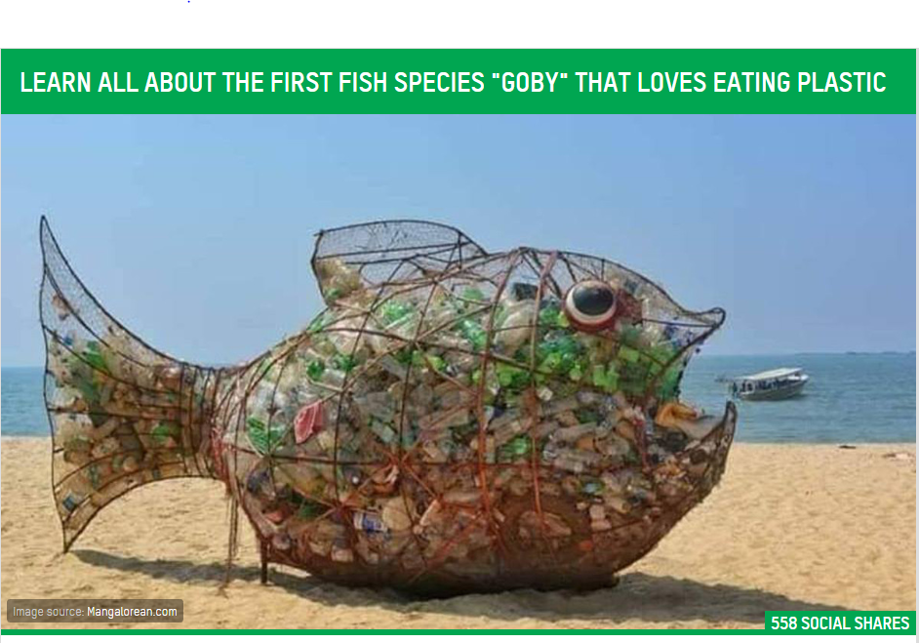
Inspiration

Slide 5
Project objective
What is TAS?
Gamify the act of throwing away rubbish
LCD Counter
Buzzer song
Fun design

Slide 6
VIDEO!

Slide 7
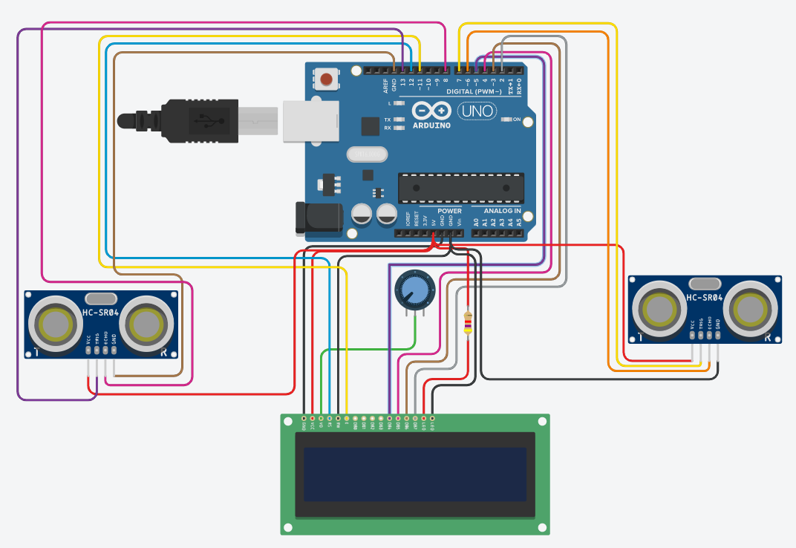
Schematic for LCD Counter

Slide 8
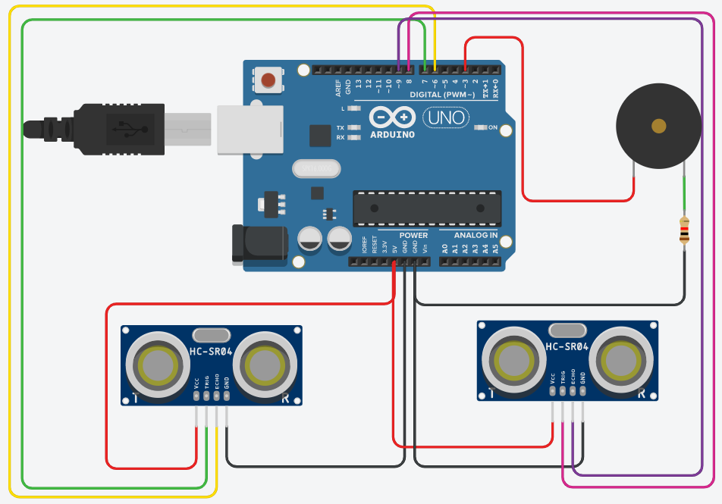
Schematic for Buzzer

Slide 9
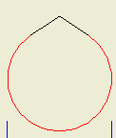
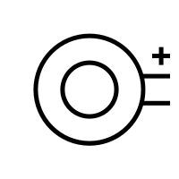



Problems encountered
1
2
3
4
Volume of buzzer during field testing was too soft
Solar panel that we had wasn’t compliant to the voltage needed to charge the power bank (our charge controller) as it only amounted to 3v maximum ( 5v> minimum)
3D printed pieces with holes to fit screws, had difficulty fitting in the screws due to final layer of circle being flat
Bin was difficult to carry
Notes:
These are some of the problems our group has encountered
Volume of buzzer during field testing was too soft Solution-Fixed by increasing volume in code
Rational: Easiest and cheapest method
, weight of the bin, solar panel that we had wasn’t compliant to the voltage needed to charge the power bank (our charge controller) as it only amounted to 3v maximum ( 5v> minimum).
There were mistakes when cutting/drilling the wood, causing the face of the wood to have wrong holes/ cuts Solution-This was fixed by using wood putty

Slide 10
Advantages of TAS
~Clear rubbish passively
~Low maintenance
~Self sustaining
~Weather resistant
~Tamper resistant
~Used for surveying
~Buzzer and design makes TAS attractive

Slide 11
Disadvantages of TAS
~Has to be under sunlight
~Bin is heavy
~3D printed parts takes very long
~May short circuit if toppled over

Slide 12
Recommendations
1)Use IC Chips such as ATTiny45 for the board
Rational: Reduce cost & space by replacing Arduino
2)For the counter, a laser and LDR could replace the ultrasonic sensor to make a ‘trip wire’
Trigger the counter when the bin flap opens
Accurate way to keep track of the number count
3) Lighter material for physical bin

Slide 13



Conclusion
Notes:
This project is an effort to gamify throwing rubbish
in public places with high human traffic such as parks and beaches in order to counter the modern day problem of such places being littered with wastes and polluting the environment. The concept arises such that the rubbish bin would be ‘gamified’ and encourage people to throw rubbish. It also doubles as a possible way to cast votes if needed because of the counting capability

Slide 14

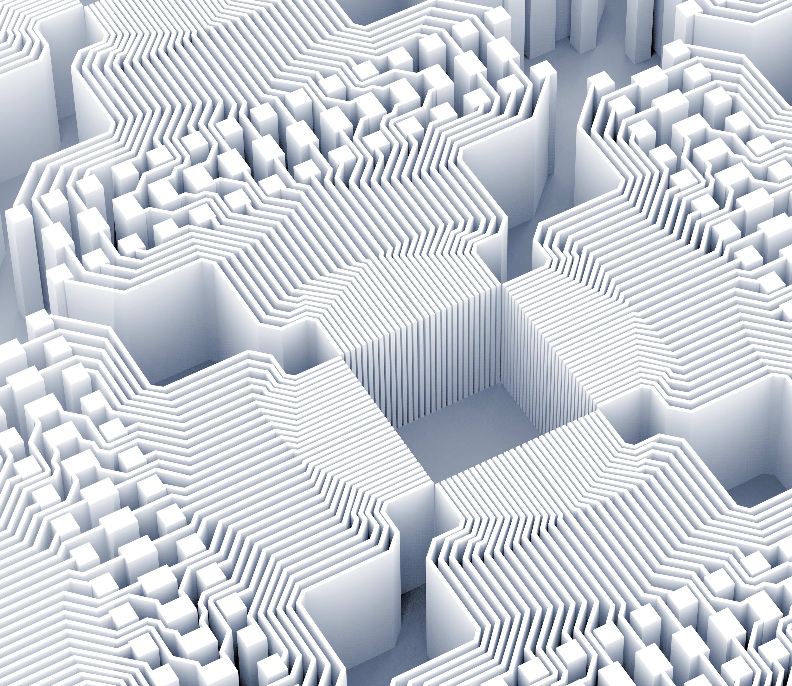

Thank you!
Online Report ☺ Youtube Video ☺

Slide 15
Q&A SESSION!

Slide 16
References
https://thenounproject.com/term/buzzer/120957/
https://icon-library.net/icon/heavy-icon-22.html
https://www.trzcacak.rs/imgm/iTmRbox_solar-panel-comments-solar-panel-free-icon/
https://www.trzcacak.rs/imgm/iTmRbox_solar-panel-comments-solar-panel-free-icon/

